Slide 1

Course Name - Object Oriented Programming using Java
Lecture 9– Creation of class, object, method
Presented By
Dr. Sudipta Sahana
Asso. Prof.
Dept. of CSE
UEM - Kolkata

Slide 2
Topic of Interest
Objects and Classes in Java
Classes in Java
Creating an Object
Memory Allocation in Java
Method in Java
Method Declaration
Access Specifier

Slide 3
Objects and Classes in Java
In object-oriented programming technique, we design a program using objects and classes. An object in Java is the physical entity, whereas, a class in Java is a logical entity only.
Object Definitions:
An object is a real-world entity.
An object is a runtime entity.
The object is an entity which has state and behaviour.
The object is an instance of a class.

Slide 4
Classes in Java
A class is a blueprint from which individual objects are created.
A class can have any number of variables which will store the data.
.
public class Dog {
String breed;
int age;
String color;
}

Slide 5
Creating an Object:
A class provides the blueprints for objects. So basically, an object is created from a class. In Java, the new keyword is used to create new objects.
There are three steps when creating an object from a class −
Declaration − A variable declaration with a variable name with an object type.
Instantiation − The 'new' keyword is used to create the object.
Initialization − The 'new' keyword is followed by a call to a constructor. This call initializes the new object.

Slide 6
Memory Allocation in Java
1 It’s note worthy that all the memory allocation takes place in run time only and only when the class in loaded in the memory. Loading of classes at runtime will be discussed later on.
2 All the non-static data (variables and constants) are allocated memory individually for each object that is created. These are known as Instance data member.
3 All static data are allocated memory only once when the class is loaded in the memory. These are shared among all the objects of the class. They are known as class data member.
4 Methods, static or non-static are shared among objects and allocated into memory only once.
5 Static methods are allocated into memory only once when the class is loaded into memory
6 Non-static methods are allocated memory only once when the first object of the class is instantiated.

Slide 7
What is a method in Java?
A method is a block of code or collection of statements or a set of code grouped together to perform a certain task or operation. It is used to achieve the reusability of code. We write a method once and use it many times. We do not require to write code again and again. It also provides the easy modification and readability of code, just by adding or removing a chunk of code. The method is executed only when we call or invoke it.

Slide 8
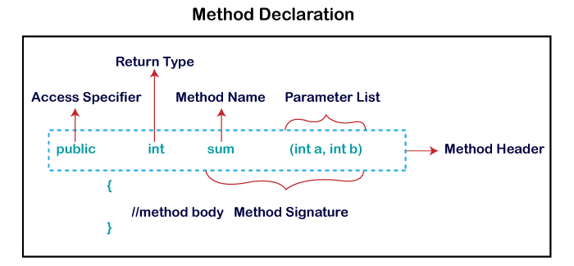
Method Declaration
The method declaration provides information about method attributes, such as visibility, return-type, name, and arguments. It has six components that are known as method header, as we have shown in the following figure.

Slide 9
Access Specifier
Access specifier or modifier is the access type of the method. It specifies the visibility of the method. Java provides four types of access specifier:
Public: The method is accessible by all classes when we use public specifier in our application.
Private: When we use a private access specifier, the method is accessible only in the classes in which it is defined.
Protected: When we use protected access specifier, the method is accessible within the same package or subclasses in a different package.
Default: When we do not use any access specifier in the method declaration, Java uses default access specifier by default. It is visible only from the same package only.

Slide 10
Thank You

Slide 11


